Slide 1
CPSIA Vendor Documentation Manual
MERCHANT OPERATIONS REGULATORY COMPLIANCE Created: 10/2023 Process owner: Regulatory Compliance Version: 2.0 Last Amended: 2/15/2024
Updated 2/15/2024

Slide 2
Table of Contents
Overview Page 2
Documentation – Checklist Page 3
Documentation – Reminders Page 4
Documentation – Exemptions Page 5
Documentation – Upload Guidelines Page 7
FAQs Page 8
Contacts Page 9
Appendices Page 10

Slide 3
Overview
The Consumer Product Safety Improvement Act (CPSIA) is a U.S. law that requires importers and domestic manufacturers to ensure certain consumer products have been properly tested and certified as meeting applicable mandatory safety standards. CPSIA is administered by the U.S. Consumer Product Safety Commission (CPSC). For more information on covered products and testing requirements visit the CPSC’s website: Consumer Product Safety Act
Effective March 19th, 2024 products* that use button cell and coin batteries as well as individually packaged button cell and coin batteries will be covered products under CPSIA.
When Ross is the Importer of Record for CPSIA-impacted products, vendors must:
Meet all CPSIA and Ross requirements detailed on the partners website: Ross Vendor Partners
Submit required documentation accurately to freight forwarder on a per shipment basis
Submitted CPSIA documentation is reviewed and approved by Ross’ Regulatory Compliance team to confirm that vendors’ products meet all applicable CPSIA requirements. Submissions are on a PO/Style basis. All impacted orders require CPSIA documentation approval in the freight forwarder system prior to vendor shipping.
The following pages detail Ross’ CPSIA documentation requirements and how to submit documents to the freight forwarder.
* Toys with button cell or coin batteries are exempt, as they are regulated under the Toy Safety Standard.

Slide 4
Documentation – Checklist
Vendors must provide current Ross forms and CPSIA test reports on a per shipment basis.
The checklist below specifies Ross forms required based on product type and testing:
 | CHILDREN’S PRODUCT |  | ADULT/GENERAL USE PRODUCT
 | Tested Under Vendor’s Program | Testing of Actual Product | Tested Under Vendor’s Program | Testing of Actual Product | Exempt from Testing/Meeting Requirements
1. Product Cover Form | ü | ü | ü | ü
2A. Children’s Product Certificate | ü | ü
2B. General Conformity Certificate |  |  | ü | ü | ü*
3A. Product Sample Size Form |  | ü
3B. Periodic Testing Program Form | ü
3C. Reasonable Testing Program Form |  |  | ü
CPSIA Test Reports | ü | ü | ü | ü
* Products exempt from testing requirements will be detailed on page 4
Blank copies of Ross Forms can be found in the Compliance section on the partners website: Ross Partners Portal
3

Slide 5
Documentation – Reminders
Per Ross policy, vendors must ensure all documentation is complete and meets CPSIA requirements.
Below are reminders for vendors when completing documentation for Ross approval:
Ross Forms | Test Reports
Forms submitted must be for the current year Complete all required forms/certificates for product type Complete all required fields on forms/certificates Do not submit both a GCC and CPC for the same product Do not submit GCC or CPC for other retailers Do not submit forms related to Children’s Products if the product is intended for Adults/General use | Must show passing test results for CPSIA requirement(s). Testing for other markets such as the EU, Australia or Canada will not be accepted Products intended for children ages 12 and under must be tested by a CPSC-accepted third-party testing lab Must include the Ross styles being purchased Must be within a year of the product manufacture date Draft reports cannot be submitted in place of final lab issued reports
For instructions on how to complete applicable Ross Forms, see appendices pages 11-21

Slide 6
Documentation – Exemptions
Per CPSIA regulations, the chart identifies product types that are exempt from providing a test result for the specific testing standard, and the Ross documentation requirements for each:
Product Type | Exemption Criteria | Ross Requirement
Adult Furniture | Furniture that does not contain scrapable surface coating Testing Exemption: Lead in Surface and Coating -16 CFR 1303 | Submit a partial GCC form stating the reason of exemption for the PO/Style. See page 6.
Adult Apparel | Fiber content must be made entirely from any of the following fibers or entirely from the combination of the following fibers: acrylic, nylon, polyester, modacrylic, olefin, wool and/or Fabric weight, regardless of content, weighing 2.6 ounces per square yard or more Testing Exemption: Flammability in Textile Clothing - 16 CFR 1610
Small Rugs/Carpets | Floor covering made of fabric or similar material with an appropriate warning label Rug/carpet must be less than 6 ft long and less than 24 square ft Does not pass flammability requirements Testing Exemption: Surface Flammability - 16 CFR 1630/1631 | Photo of the actual product and Photo of the flammability label attached and Submit a partial GCC form stating the reason of exemption for the PO/Style. See page 6.
Note: Products that do not meet their specific exemption criteria must provide all required documentation and testing.

Slide 7
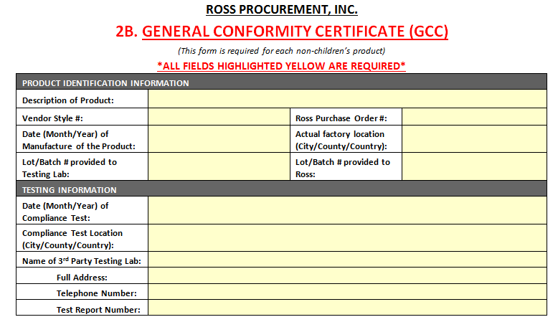
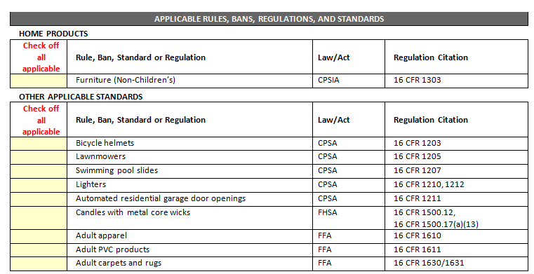
Documentation – Exemptions (cont’d)
Partial GCC forms submitted must list all exempt PO’s and styles.
The following fields should be completed and have the exempt product’s applicable rules and standards checked off:
Page 1 of GCC Page 2 of GCC
Note: Exemption reason must be stated in the “Date (Month/Year) of Compliance Test” field.

Slide 8
Documentation – Upload Guidelines
To avoid shipping delays due to CPSIA documents, vendors must upload all documents in the freight forwarder system according to the below guidelines:
Documents must be uploaded to the shipping order at the time of booking
Documents should be provided at least 14 days before the start ship date
Documents must be uploaded as a .pdf or .doc file using the correct document type:
"CPSIA GCC Test Docs: Attached Doc"
Additional Best Practices:
Ross forms should be uploaded as a complete packet. Forms should not be separated.
File names for each document uploaded should be clear and descriptive
Include the PO, style code, and document type (Ross form or test report) in the file name
Zip files are preferred when uploading multiple files – this keeps relevant documents together
For instructions on uploading CPSIA documentation, see appendices pages 22-27

Slide 9
FAQs
Documentation
What CPSIA testing is required for my product? | Vendors should consult with a CPSC-accepted lab on requirements for children’s products. For any general use products, vendors should consult with any third-party testing lab.
My product is exempt from CPSIA requirements. What documentation is required? | Vendors must complete a Partial GCC form. Required information is detailed on page 5.
Can I upload one Ross form packet for multiple styles? | Vendors may put multiple styles onto one set of Ross form packets if: ALL styles are on the same purchase order and ALL styles are covered by the same test report
Uploading
Why am I receiving emails that documentation was not uploaded? | Vendors must ensure CPSIA documents have been uploaded using the doc type ”CPSIA GCC Test Docs: Attached Doc”. Missing documents or documents uploaded using an incorrect doc type will trigger this email.
Which file types should I use when uploading my documents? | Vendors must upload as .pdf .doc files or .zip folders. .Rar files are not accepted.
CPSIA RTP reached out asking for documentation. Can I send via email? | Vendors should upload revised or new documents directly to their shipping order in the forwarder system. Any documents sent via email will not be approved.
If you have any additional questions regarding requirements, please contact CPSIA.RTP@ros.com

Slide 10
Contacts
NAME | TITLE | EMAIL
Briana Binder | Sr. Manager, Compliance | briana.binder@ros.com
Amanda Santiago | Supervisor, Compliance | amanda.santiago@ros.com
CPSIA RTP | Inbox | CPSIA.RTP@ros.com

Slide 11
APPENDICES

Slide 12
CHILDREN’S PRODUCT
This packet includes required Ross forms for Children’s Product.
All fields highlighted in yellow are required.
The following must be completed and submitted by the vendor:
1A. Children’s Product Cover Form
2A. Children’s Product Certificate
3A. Testing Sample Size OR 3B. Periodic Testing Program Form
Applicable test reports

Slide 13
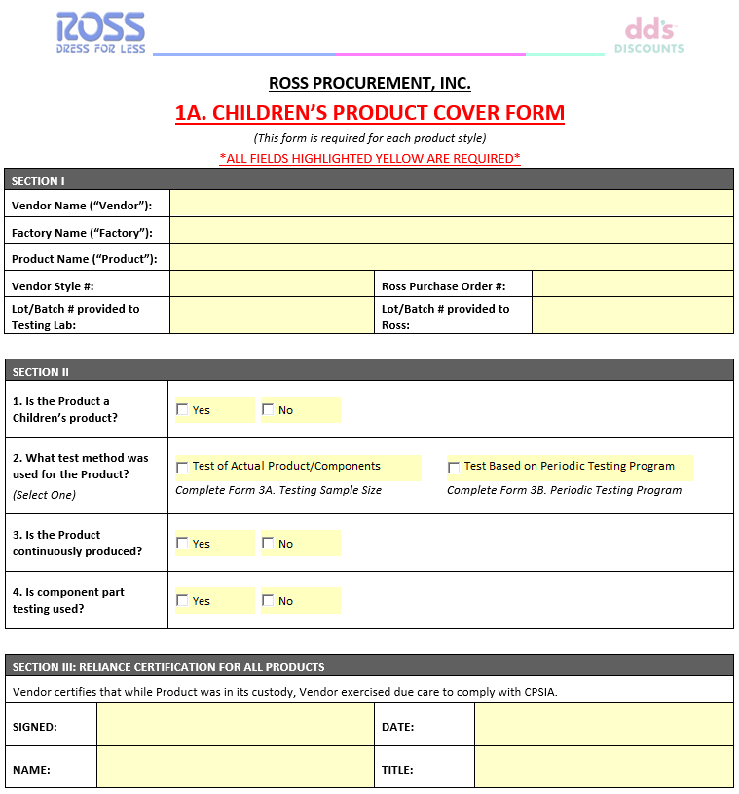
1A. Ross Product Cover Form
The Cover Form is required for all Children Products. This form certifies the specific product is within CPSIA compliance.
ALL fields in the section highlighted yellow below must be completed. Vendors should also ensure the following:
Ross PO details must match booking details and all corresponding forms
An additional form is required based on vendor selection in Section II
If testing was of the Actual Finished Product, complete form 3A
If testing was based on Periodic Testing Program, complete form 3B
Only complete the form relevant to testing method used for the product
Cover Form must be signed and dated at the bottom
12

Slide 14
2A. Children’s Product Certificate (CPC)
The Children’s Product Certificate (CPC) certifies the product was tested by a CPSC-accepted laboratory and complies with applicable children’s product safety standards.
ALL fields in the section highlighted yellow below must be completed. Vendors should also ensure the following:
Ross PO details must match booking details and all corresponding forms
Testing Information section must match details of Test Report(s) provided
Test report date must be within a year of manufacture date

Slide 15
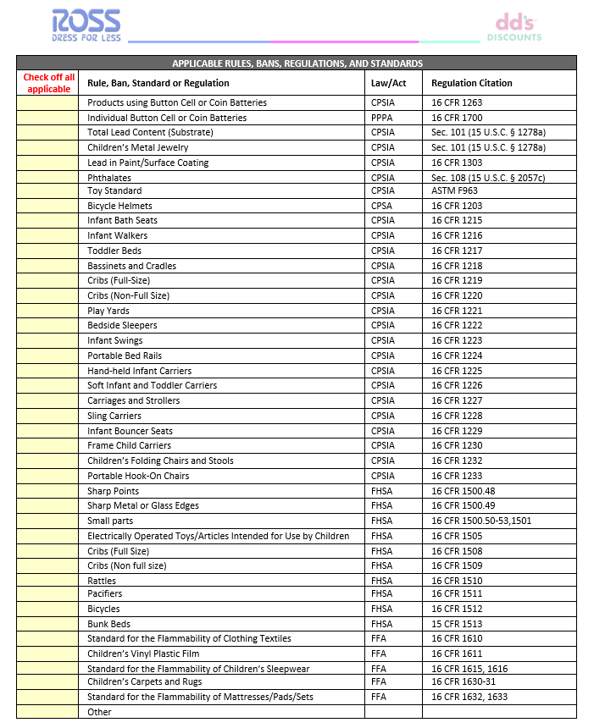
2A. Children’s Product Certificate (CPC) cont’d
Vendor must check off all Applicable Rules, Bans, Regulations and Standards to certify specific testing performed based the product type.

Slide 16
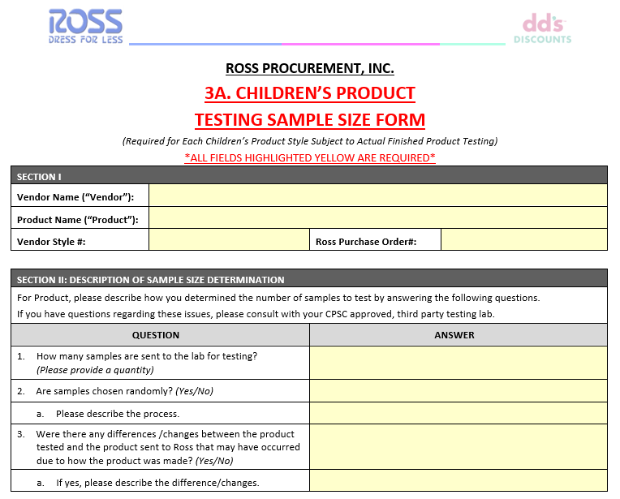
3A. Sample Size Form
The Sample Size Form should be completed if testing was of the Actual Finished Product.
ALL fields in the section highlighted below must be completed. Vendors should also ensure the following:
Ross PO details must match booking details and all corresponding forms
In Section II, Vendor should clearly describe how all factors of the testing process were determined

Slide 17
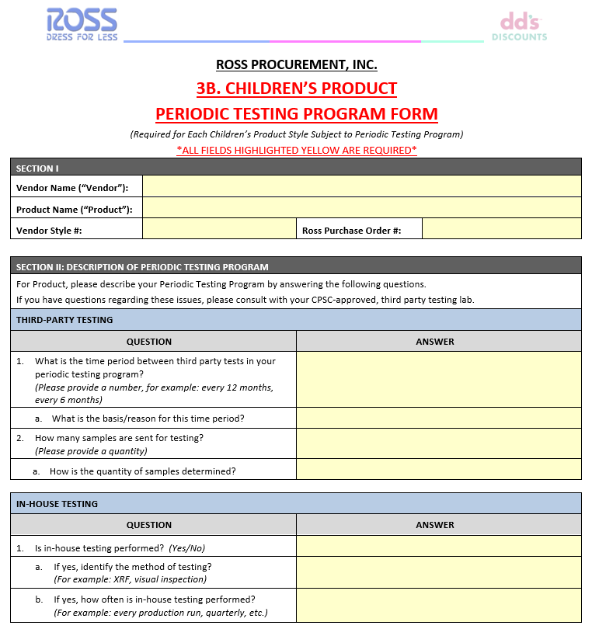
3B. Periodic Testing Program Form
The Periodic Testing Program form should be completed if testing was based on Periodic Testing Program. This form certifies that the vendor has a periodic testing plan and conducts periodic testing.
ALL fields in the section highlighted below must be completed. Vendors should also ensure the following:
Ross PO details must match booking details and all corresponding forms
In Section II, Vendor should clearly describe how all factors of the testing process were determined
16

Slide 18
NON-CHILDREN’S PRODUCT
This packet includes required Ross forms for Non-Children’s Product.
All fields highlighted in yellow are required.
The following must be completed and submitted by the vendor:
1B. Non-Children’s Product Cover Form
2B. General Conformity Certificate
3C. Reasonable Testing Program Form (if applicable)
Applicable test reports

Slide 19
1B. Ross Product Cover Form
The Product Cover Form is required for all Non-Children’s Products. This form certifies the specific product is within CPSIA compliance.
ALL fields in the section highlighted below must be completed. Vendors should also ensure the following:
Ross PO details must match booking details and all corresponding forms
An additional form is required based on vendor selection in Section II
If testing was based on Reasonable Testing Program, complete form 3C
Only complete the form relevant to testing method used for the product
Cover Form must be signed and dated at the bottom

Slide 20
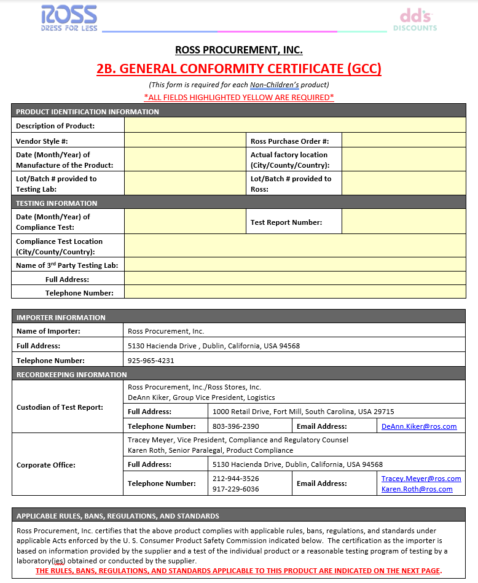
2B. Non-Children’s Product Certificate (GCC)
The Non-Children’s Product Certificate (GCC) certifies the product was tested by a third party laboratory and complies with applicable non-children’s product safety standards.
ALL fields in the section highlighted below must be completed. Vendors should also ensure the following:
Ross PO details must match booking details and all corresponding forms
Testing Information section must match details of Test Report(s) provided
Test reports must be within a year of manufacture fields must be within one year

Slide 21
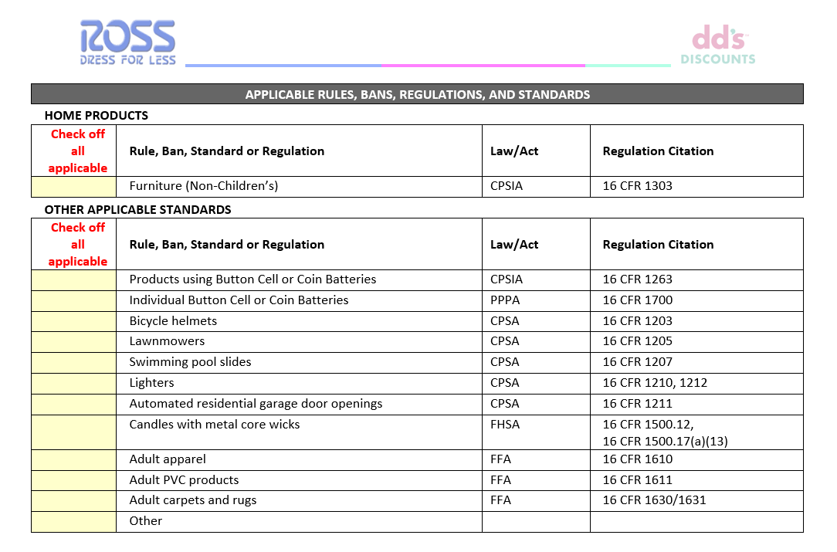
2B. Non-Children’s Product Certificate (GCC) cont’d
Vendor must check off all Applicable Rules, Bans, Regulations and Standards to certify specific testing performed based the product type.

Slide 22
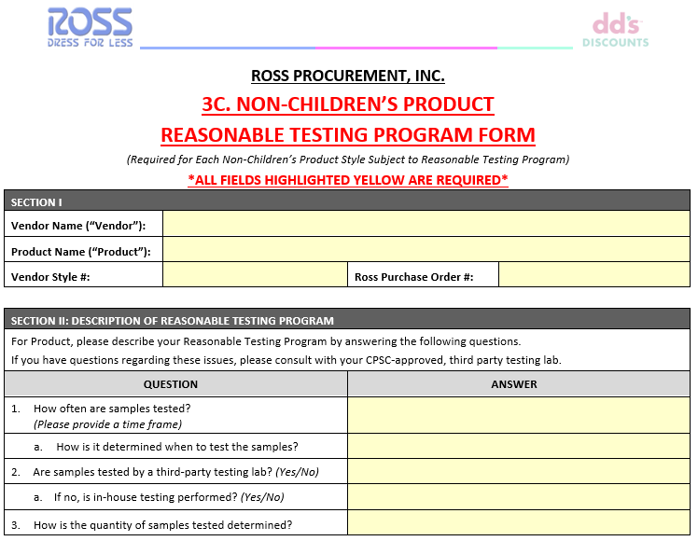
3C. Reasonable Testing Program Form
The Reasonable Testing Program Form should be completed if testing was based on a Reasonable Testing Program. This is based on the vendors reasoning concerning the testing methods conducted on the products.
ALL fields in the section highlighted below must be completed. Vendors should also ensure the following:
Ross PO details must match booking details and all corresponding forms
In Section II, Vendor should clearly describe how all factors of the testing process were determined

Slide 23
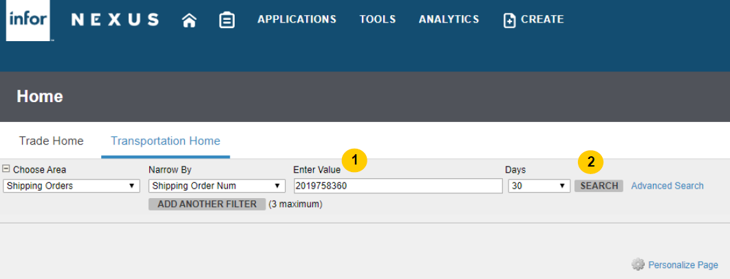
Uploading documents in DHL/ACS: User Guide
Search the Shipping Order (SO) number by entering the Purchase Order (PO) number
Click “Search”
1
2

Slide 24
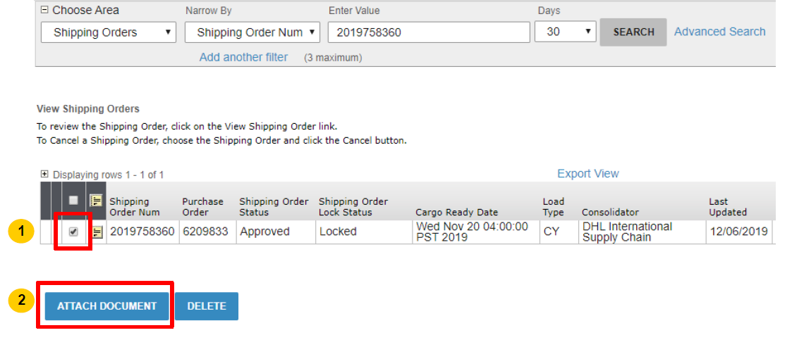
Uploading documents in DHL/ACS: User Guide
Select the Shipping Order
Click 'ATTACH DOCUMENT'
3
4

Slide 25
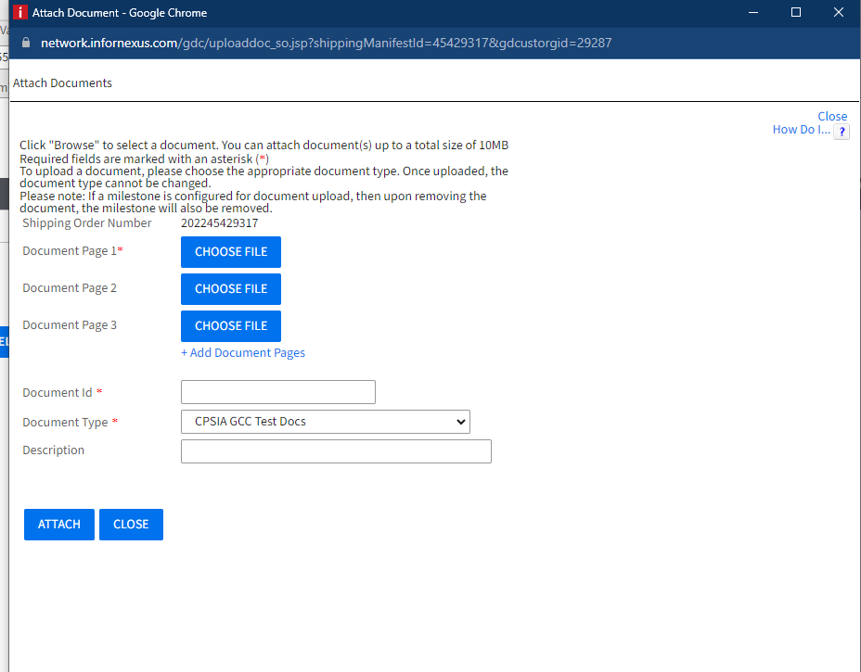
Uploading documents in DHL/ACS: User Guide
A pop-up window will appear, click 'CHOOSE FILE' to select documents to upload
Upload as Document Type "CPSIA GCC Test Docs: Attached Doc"
5
6

Slide 26
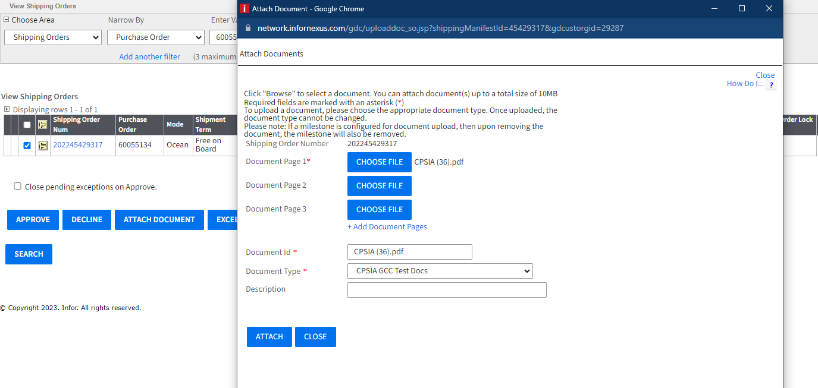
Uploading documents in DHL/ACS: User Guide
After the document is chosen, the file name will be displayed next to ‘CHOOSE FILE’ and ‘Document Id.’
Choose the Document Type ’CPSIA GCC Test Docs: Attached Doc’ from the dropdown list.
Click 'ATTACH' to upload the document.
7
8
9

Slide 27
Viewing and Revising Uploaded Documents
To check if a document is uploaded correctly, click 'View' under the View Document column. If the document appears in the next screen, it has been successfully uploaded.

Slide 28
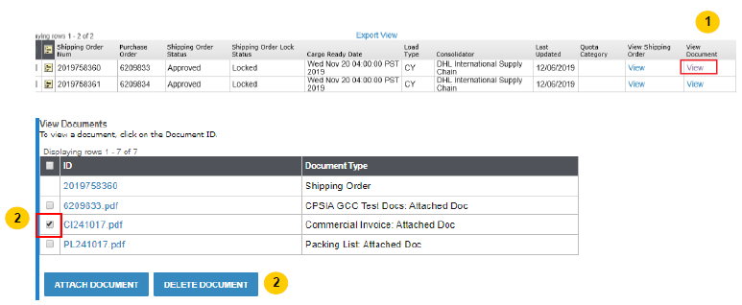
Viewing and Revising Uploaded Documents (cont’d)
Vendors should re-upload any revised documents to quickly alert the forwarder and CPSIA team that changes have been made. Outdated documents should be deleted from the shipping order.
Select outdated files and click 'DELETE DOCUMENT.'
3

